Slide 1



MCA: Interview Preparation SIG
Samuel Bishop

Slide 2
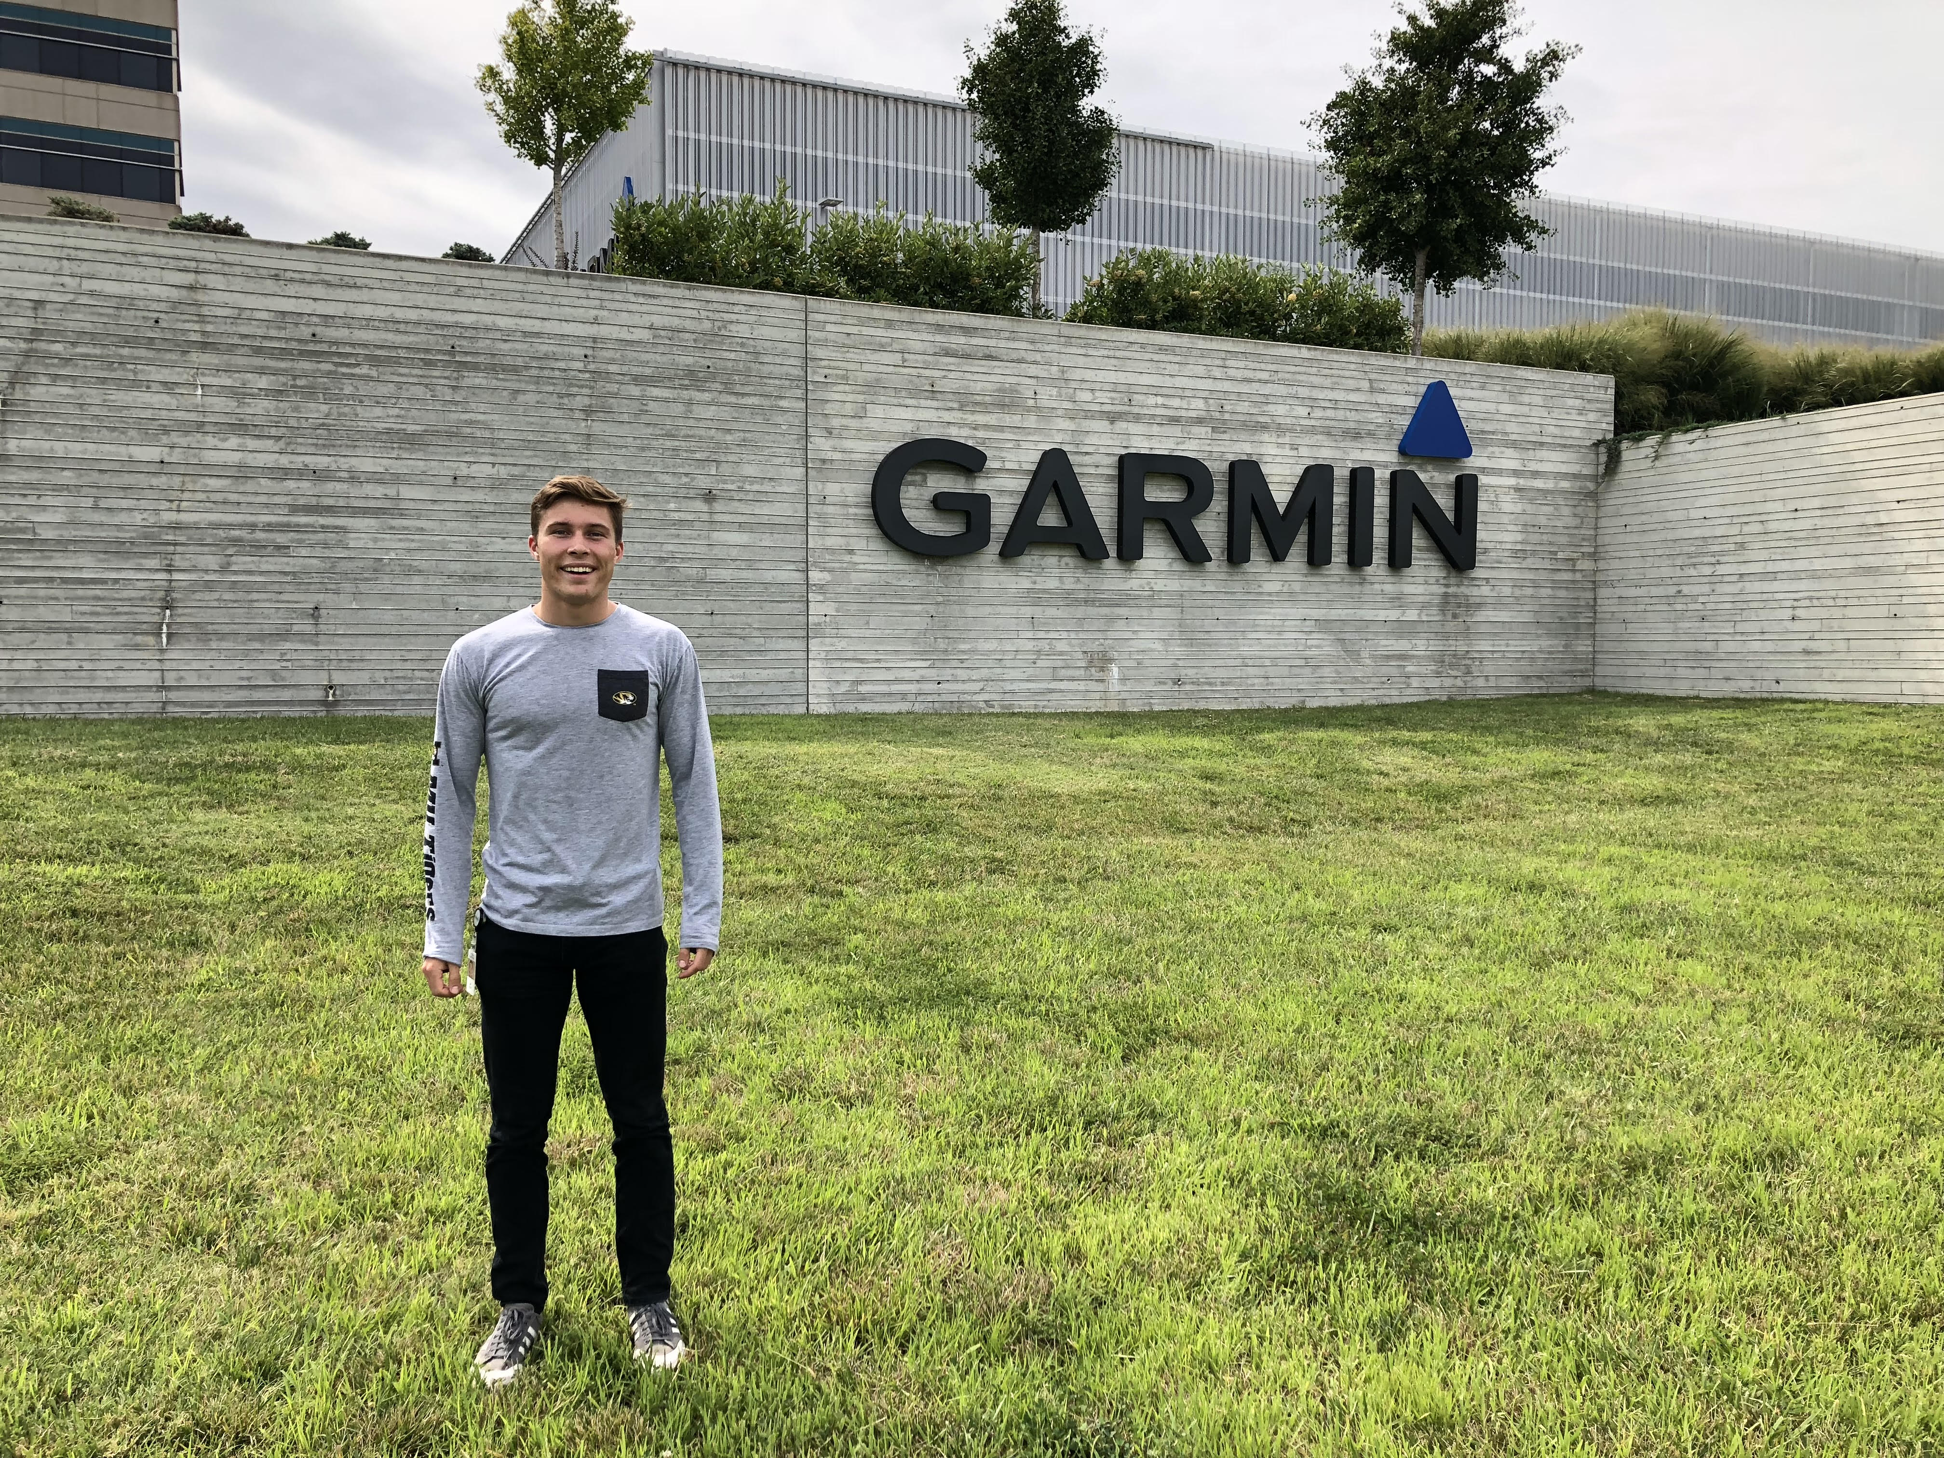

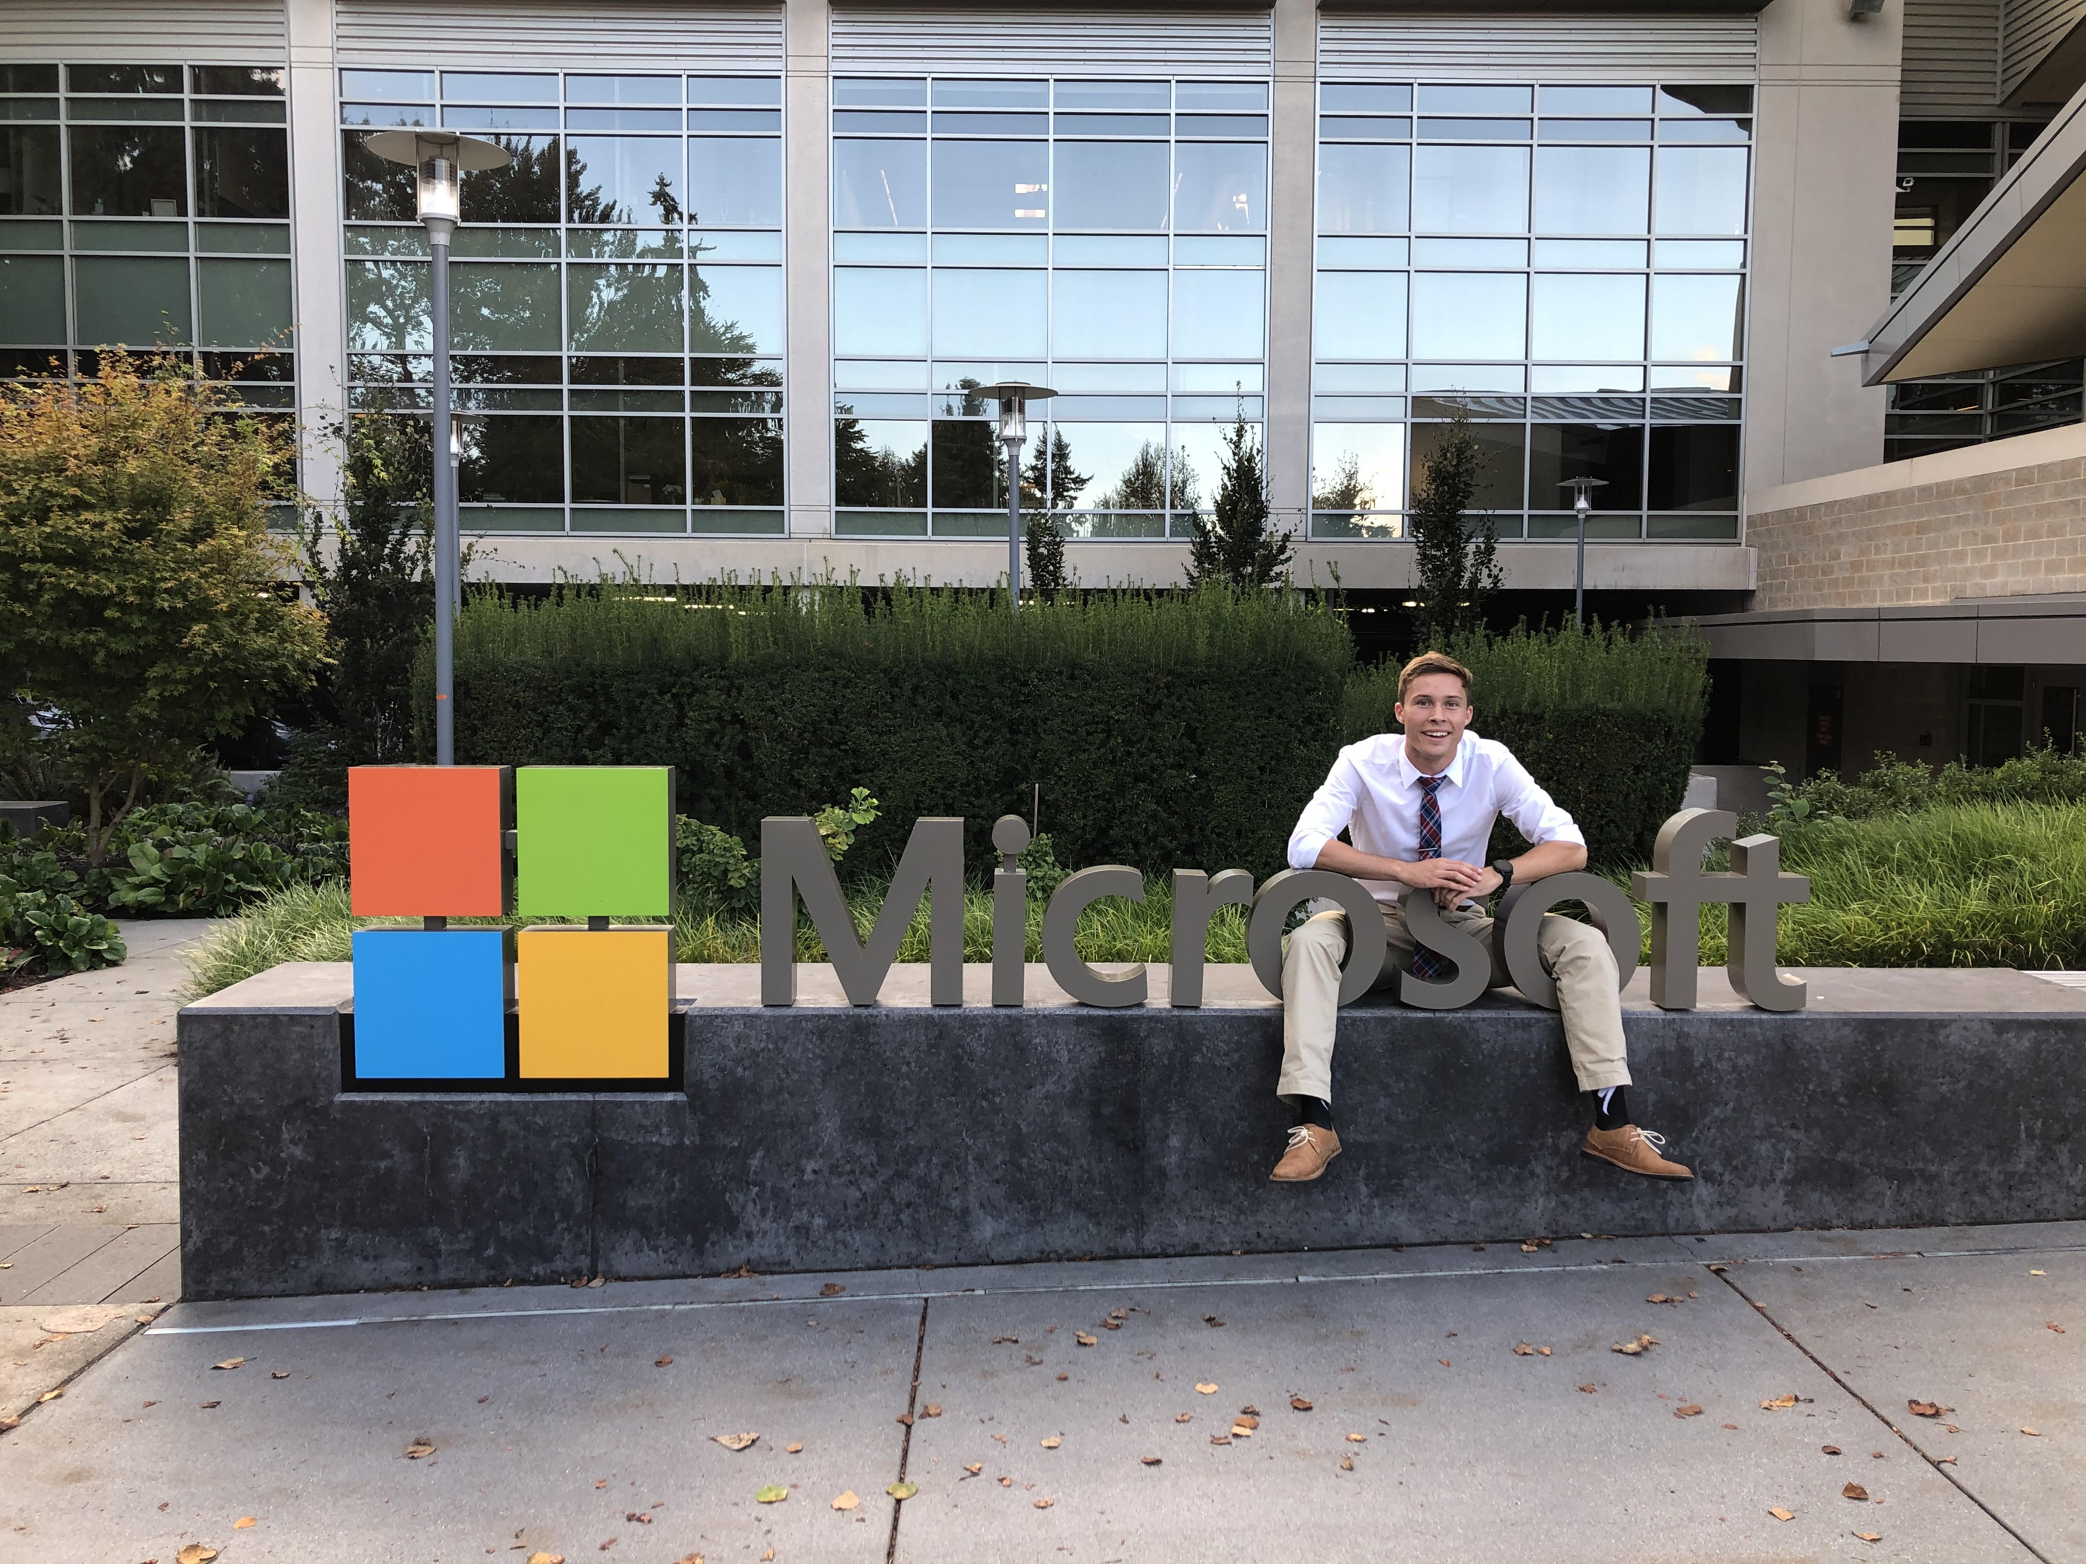
Personal Introduction
Major: ECE
Year: Senior
Hometown: Madison, WI

Slide 3
SIG Objective
Understand Technical interviews
Learn Content related to the interviews
Practice interviewing

Slide 4
SIG Format and Schedule (Subject to Change)
1. Mini-Lecture on prepared topic
2. Coding concept overview
3. Practice
Engagement improves rate of learning. Don’t be shy to interrupt, ask questions, or share answers!
Practice Interviews may be scheduled periodically.
Feb 2 – Introduction
Feb 9 – Behavioral Interviewing/ Best Practices, Arrays and Strings
Feb 16 - Coding Interviews/ Best Practices, Linked Lists
Feb 23 – In Depth Look of Occupations that commonly use CS, Stacks and Queues
Mar 2 – Trees and Graphs
Mar 9 – Sorting
Mar 16 - Searching
Mar 23 and on - TBD

Slide 5

What Software Jobs Exist?
Generalized Full-Stack Software Engineer
Front-End
UI/UX
Mobile
Back-End
Functionality
Data Analytics
Game Design
Integrations/Test Engineering
Cyber Security
Information Technologies
Systems Design and Architecture
MANY MORE

Slide 6

Why Do I Want an Internship/Co-Op?
Experience and Content
Application of concepts more valuable than theory in gaining proficiency
Interpersonal Connections
Really cool and passionate people
Monetary Value
Companies in Midwest average $20-25/hr
Large tech companies pay bank
Improves personal value
Quite literally the best time investment ANYONE can make in college
THERE IS ONE EXCEPTION TO THIS RULE - Academia

Slide 7

Opportunities
Feb 24. Virtual Mizzou Engineering Career Fair
Link: https://engineering.missouri.edu/current-students/academy/career-fair/

Slide 8

The Behavioral Interview
HR Person
Everything that doesn’t have to do with coding
Resume
Transcripts
Cover Letter
Gimme Questions
Why do you want to work here?
What skills do you have that would make you valuable here?
Describe a time you’ve experienced conflict. How did you resolve it?
NOTE: We will be going over resume tips, examples, and behavioral best practice NEXT WEEK.

Slide 9

The Technical Interview
Meant to assess your skill as an engineer
Interview (~45min):
Resume/Behavioral
(~5-10min if occurs)
Coding Portion (Generally the rest of the interview)

Slide 10
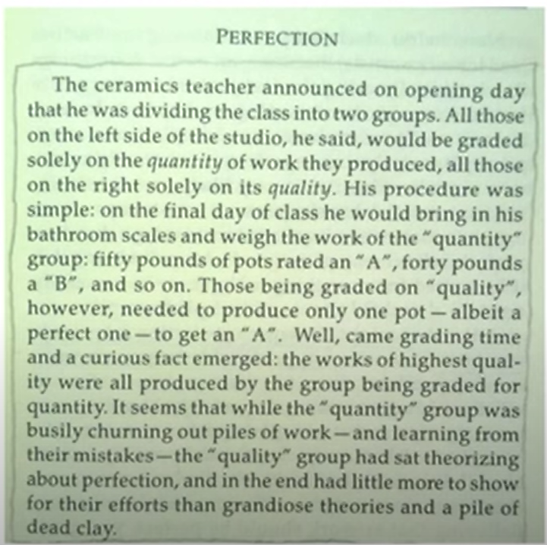
Dealing with Rejection

Slide 11
Resources
AlgoExpert Subscription
Username: mcainterviewprep@gmail.com
Password: aceThisInterview4200
SIG GitHub Repo -> VS Code and Python Setup
Link: https://github.com/SamuelBishop/MCA-SIG-Interview-Prep
Accessory Sites:
https://www.glassdoor.com/
https://triplebyte.com/
https://practice.geeksforgeeks.org/
https://leetcode.com/
https://www.hackerrank.com/

